Slide 1
Pilot of an Interactive Social Marketing Initiative to Improve Family Physical Activity among Parents with Preschoolers
Erica Doxzen, School of Public Health
Irina Iles, Department of Communication
Sarah Pomerantz, School of Public Health
Dr. Linda Aldoory, School of Public Health (Faculty Mentor)
Notes:
I’m Erica
I’m Irina
I’m Sarah
And our faculty mentor was Dr. Aldoory
Our initiative sought to improve family physical activity among parents with preschoolers. Why is this important?

Slide 2
Our Motivation
35.7% of adults and 15% of preschool-aged children in the US are obese
Physical activity can reduce the risk of obesity
Parents influence the activity levels of their preschool-aged children
Notes:
Because the obesity epidemic starts young – 15% of preschool-aged children are already obese. Obesity can lead to health problems like diabetes and cardiovascular disease, but physical activity can reduce these risks. And, studies show that for preschoolers, parents can and do play a significant role in their activity levels!
[old notes]
Childhood & adult obesity continues to be a threat to health, as 35.7% of adults and 15% of preschool-aged children in the US are obese
Obesity is associated with adverse health outcomes (like diabetes among youth, and cardiovascular disease and premature mortality later in life)
Engaging in physical activity can reduce the risk for obesity- and for preschoolers, parents can and do play a significant role in their activity levels!

Slide 3
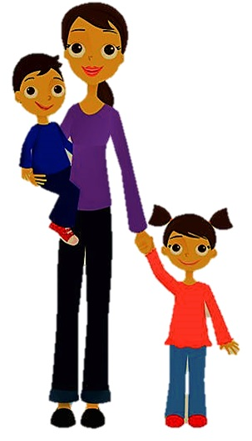
Our Vision
Parent (end user)
What should we do with our kids?
Our Team
Do you want to be active outside or inside today? Text 1 for outside, 2 for inside.
2 [inside]
Move like your child’s favorite animal (a bird or a bunny?)
while picking up toys together.
VIRTUAL
SMS LIBRARY
Notes:
Our vision was to create messages that help parents fit family physical activity into their everyday lives. By using two-way mobile text messaging, the messages would be conditional or tailored to factors such as parents’ preferences and resources.

Slide 4
Our Motivation
FiA Priorities:
Credibility
InfoEquity
InfoTransfer
Notes:
We wanted to create a product that would deliver credible health information to parents, who may struggle to find accurate and trustworthy information about their family's health.
We know that mobile texting continues to grow, especially among racial and ethnic minorities. Disseminating health information via text can help to close the digital divide.
And, interactive texting is a novel approach to disseminating expert health information in a more usable and accessible way. Unlike traditional health education campaigns, it also enables users to share information with the messaging system.
[old notes]
Credibility: Through focus groups with parents of preschoolers- we found that parents may not know where to go to get accurate, trustworthy information about their families health. And many parents of preschoolers look to their peers for ideas and tips for how to make their family healthier.
So we wanted to create a product that would easily deliver credible information to parents of preschoolers, in a friendly and accessible way!
InfoEquity: As of 2013, we know 91% of people in the US own a cell phone. And of those only 56% own smart phones but 81% use text messaging (with even higher rates among African Americans and Hispanic/Latino populations)!
So we felt that disseminating our health information via text messaging would be an effective way to address the digital divide, providing information and resources to those that may not have Internet access
InfoTransfer: Given the lack of accessible, credible information about family physical activity for families with preschool-aged children, and the high rates of using text messaging across all racial/ethnic populations in the U.S.- we felt that creating a text message initiative would be an effective way to translate expert information for broad use by parents of preschoolers, to increase family activity!

Slide 5
Creation and Research
Draft sample messages
Conduct 4 focus groups in community settings (n=17)
Develop pilot message library
Deliver tailored messages in 7-day pilot test
Conduct interviews with pilot test participants (n=16)
Refine message library
This research was approved by the University of Maryland Institutional Review Board.
Notes:
During this project, our team followed an iterative, user-centered approach to create and evaluate a message library, including focus groups with parents, a week-long message pilot, and follow-up interviews.

Slide 6
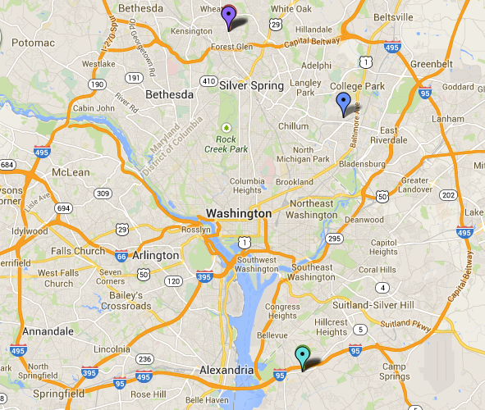
Focus Groups at a Glance
“I like the idea of reminding that that’s something you can do, just jumping jacks or a quick game of hide and seek.” – Caucasian mother
“I don’t know what type of luxurious home you live in but I don’t have many hiding spaces, so hide and seek would be over with extremely fast. I’m in a one level rambler so there’s really nowhere to go.” – African-American father
1 | Wheaton, MD | 5 Caucasian Participants
2 | Hyattsville, MD | 3 Hispanic English-Speaking Participants
3 | Oxon Hill, MD | 4 African-American Participants
4 | Hyattsville, MD | 5 Hispanic English-Speaking Participants
Notes:
Focus groups were held in community settings in Prince George’s and Montgomery Counties with a very diverse group of participants. The purpose of focus groups was to gather input on content and interaction. As you can see in these quotes, it was clear that the message tailoring would allow parents with different preferences and resources to get information that would be relevant and useful to their everyday lives.
We analyzed the findings from the focus group to develop messages and tailoring logic for our pilot study.

Slide 7
Pilot Test at a Glance
Participants received 7 days of interactive messages sent using Google Voice SMS
Interviews conducted by phone
“I didn't know if you guys specialize or study what kids like, but I loved how my daughter was so excited knowing we were going to do an activity with the balloons – ‘Here Mommy, Here Mommy!” – Hispanic mother
Notes:
We used Google Voice to send 7 days of interactive messages to participants, a sample exchange is shown here. Messages included activity ideas, health facts, and support. After the week of messages, we interviewed participants to gather feedback on satisfaction, usefulness, and behavior. Feedback was generally very positive, with participants appreciating the interactivity and many reporting that they had actually done the activities with their kids.
[notes:]
16 phone interviews completed April 2-7
7 English-speaking Hispanic
5 White / Caucasian
4 Black / African American
1 Caribbean

Slide 8
Outcomes and Impact: Credibility
Value of “curated” content
Opportunity to guide information seeking
Different beliefs about message content
Need to consider culturally appropriate frames
Willingness to share information via text
Opportunity to get public health data in real-time
Notes:
So what did we learn about the future of information:
First, parents appreciated messages with “curated” health facts. We can guide people to credible information.
Also, our diverse group of participants shared their beliefs and values. For example, some Hispanic mothers wanted to hear that engaging in family physical activity is part of being a good parent, while Caucasian parents preferred to avoid messages that they saw as judging their parenting skills. We found that took pains to make sure that the messages would be credible and relevant for participants from different racial and ethnic backgrounds generally found the messages to be credible and relevant.
Finally, people are willing to share information by text with a trustworthy source. This has implications for public health’s ability to gather big data in real time to monitor health trends.
[old notes]
Value of “curated” content - links that we’d selected for use in knowledge messages were seen as trustworthy, helpful
Implication: The use of disseminating credible information via text is a way to guide information seeking (to improve this behavior)
different beliefs about value of family physical activity
Implication: thus, when promoting family physical activity and its benefits to parents, different frames that incorporate core cultural values should be used; for example, a message targeted at a Hispanic mother should emphasize that a good mother takes time to engage in physical activity with her children and teaches them the importance of being physically active
people are willing to share information by text
Implication: this serves as an opportunity to collect public health data in real-time (could be used for monitoring);

Slide 9
Outcomes and Impact: InfoEquity
Different information behaviors
Access to technology ≠ use of technology
Different resources
“Pandora” model for adaptive learning
Notes:
What about equity? We found that across different groups of parents, although all had smartphones and internet access, they did not all use technology the same way to access information. For example, parents from wealthier communities were more likely to mention sharing information through community listserves with other parents. Texting can help reach communities who lack information resources, despite having the necessary technology.
Another implication of our project is the success in tailoring information based on people’s resources and needs. We can envision an “Pandora” model where the system learns over time what types of messages are most relevant and appropriate for your everyday life.
[old notes]
different information behaviors (i.e., white parents involved in neighborhood listservs; use of phone as primary internet access point by parents with fewer economic resources)
Implication: access to technology does not mean people use it in the same manner
different resources in everyday life that may impact family PA (i.e., living in apartment, working full-time, etc)
Implication: this means that, based on their resources and living situation, different parents might find some types of messages useful, but not others. For example, a family might not find high intensity physical activities so useful for various health reasons, but they might enjoy ideas on how to be physically active outdoors. Therefore, we recommend an on-demand texting system, similar to what Pandora does: I like this song, show me more of this type -> My kid and I loved this activity, send me similar ones in the future!

Slide 10
Outcomes and Impact: InfoTransfer
Interactive messaging works!
Message tailoring works!
Hybrid system: automated + human to human
Additional tailoring factors: time of the day to receive the message; current activity level of parent/child; locale
Texting fits into everyday life
SMS integration into “quantified self” tracking dashboard
Notes:
Finally, texting is an incredibly simple and powerful tool for sharing information.
Parents really liked the interactivity of the messages, and said the texts created a sense of urgency without being intrusive. We recommend a hybrid system with message automation but the ability to contact a human for support and to provide additional feedback.
Also, tailoring worked so well that we can see many additional factors to tailor on as the message library grows – for example, the preferred time to receive your daily tip.
And finally, texting is part of everyday life. There is potential to integrate SMS data into other quantified self tools such as tracking dashboards.
[notes]
Interactive texting was also well received- parents said receiving a message creates a sense of
urgency and requires engagement in a way that other channels may not (note: people still described pilot as “not intrusive”!)
Implications: We also found that people wanted to request more information/activities when they wanted it- so we recommend a hybrid system: automated but some way to contact a human – the human-to-human component would help us gather real-time feedback and make continual iterative improvements
Tailoring works! Personalizing the messages was well received and evoked a sense of empowerment for making choices around their activities
Implication: We recommend future projects tailor around: time of day to receive messages, current activity level of parent/child, and especially locale (zip code for accessible resources/activities)
could be used as a “quantified self model” (see what activities you’ve done)

Slide 11
Next Steps
Messages
Pilot message library refined message library
Technology
Automated system to meet the specifications found valuable during the pilot
Evaluation
Rigorous study to assess impact of initiative on parents’ attitudes, beliefs, and behaviors
Notes:
Our next steps include growing our message library and creating an automated system that tailors and delivers messages according to the specifications we found valuable during our pilot. We have had some conversations with Sesame Street Workshop and intend to follow up with them and the National Park Service regarding partnering in the future for additional funding
We would seek:
Funding to support the expansion of our pilot message library which our partners could disseminate through existing channels
And:
Funding to support the development of a fully automated system which could support sophisticated interactions, by partnering with experts from information science and computer and systems engineering.
Importantly, we know that our promising findings from the pilot study are only preliminary data. We also hope to secure funding to conduct a rigorous evaluation of the initiative to assess how the messages support behavior change.

Slide 12
Thank you!
Notes:
Our team is very grateful to FiA and the Deutsch Foundation for the chance to plant the “seed” of our initiative!

